Slide 1
OOP LAB PROJECT | CSE 1116
Smart Food Delivery Rider Assignment & Dispatch System
An OOP-Driven Real-Time Logistics Solution
Inheritance
Polymorphism
Interface
Collections
Java Swing
P
Pranta Mohajan
S
Shreya Sen
A
Arpita Paul
0222510005101025
0222510005101029
0222510005101033
Department of CSE, Premier University, Chattogram | Section A | Session 2026
Notes:
Introduce the project and the three team members.

Slide 2
2
Problem Statement & Motivation
Why manual rider assignment fails in real food delivery platforms
01
02
03
Manual Assignment
Vehicle Mismatch
Peak-Hour Bottleneck
Dispatchers pick riders by hand, wasting time and misjudging distance.
A motorbike on a short trip wastes fuel; a bicycle on a long trip delivers late.
When every rider is busy the system must not crash. It needs safe order tracking.
OUR SOLUTION
A smart dispatcher that automatically picks the right vehicle by trip distance, tracks every order, and handles 'no rider free' with a custom exception.
Smart Food Delivery Rider Assignment & Dispatch System | CSE 1116 OOPL | Premier University, Chattogram

Slide 3
3
System Architecture & Features
Phase 1: three modular entities and six functional requirements
Rider Entities
Order Data
Backend & GUI
Person, Rider, BikeRider, CycleRider
Order
DeliveryManager, RiderAssignmentGUI
3-level inheritance + Assignable interface
orderId, customerName, restaurant, address, status
HashMap + ArrayList dispatch, Swing dashboard
Functional Requirements
FR1
Register Bike / Cycle rider
FR2
Live rider list & status
FR3
Create delivery order
FR4
Auto-assign rider or throw exception
FR5
Mark Delivered, free the rider
FR6
Order history & status log
Smart Food Delivery Rider Assignment & Dispatch System | CSE 1116 OOPL | Premier University, Chattogram

Slide 4
4
UML Class Diagram
<<abstract>>
Person
RiderAssignmentGUI
<<interface>>
Assignable
-name: String
-id: String
-phone: String
+initUI()
uses
+assignOrder(Order o)
+completeOrder()
DeliveryManager
+getRoleDescription(): String
-orderList: List<Order>
-riderMap: Map<String, Rider>
extends
<<abstract>>
Rider
+addRider() +addOrder()
+assignRider(Order o)
+completeOrder(id)
+searchRider(id) / searchRider(type)
manages
-isAvailable: boolean
-vehicleType: String
-currentOrder: Order
implements
+calculateDeliveryTime(dist)
+assignOrder(Order o)
+completeOrder()
has 0..1
manages
throws
Order
NoRiderAvailable
extends
Exception
BikeRider
CycleRider
-orderId: String
-customerName: String
-status: String
+message: String
-fuelLevel: double
-maxDistanceKm: double
-maxLoadKg: double
+calculateDeliveryTime(dist)
+calculateDeliveryTime(dist)
Abstract
Interface
Concrete
Manager
Exception

Slide 5
5
Classes & Key Methods
Nine classes/interfaces, each with a single clear responsibility
Person
Assignable
Rider
Abstract class
Interface
Abstract class
getRoleDescription()
assignOrder() completeOrder()
calculateDeliveryTime()
name, id, phone with getters/setters
Uniform contract for every rider type
isAvailable, vehicleType, currentOrder
BikeRider
CycleRider
Order
Concrete class
Concrete class
Model class
calculateDeliveryTime()
calculateDeliveryTime()
toString()
Motorbike: fuelLevel, maxDistanceKm
Bicycle: maxLoadKg
orderId, customer, restaurant, address, status
NoRiderAvailableException
DeliveryManager
RiderAssignmentGUI
Custom exception
Collections manager
Swing JFrame
extends Exception
assignRider() searchRider()
initUI()
Thrown when every rider is busy
riderMap (HashMap) + orderList (ArrayList)
JTable, JButton, JTextField dashboard
Smart Food Delivery Rider Assignment & Dispatch System | CSE 1116 OOPL | Premier University, Chattogram

Slide 6
6
Core OOP Concepts in Action
Where each pillar of OOP is applied in the design
1
Encapsulation
2
Inheritance
All fields are private; access only through public getters/setters. DeliveryManager keeps its collections private.
Person > Rider > BikeRider / CycleRider. Children reuse name, id, phone and availability logic.
private fields
getters / setters
3-level hierarchy
extends
3
Polymorphism
4
Abstraction
Bike: 30 km/h, Cycle: 12 km/h. rider.calculateDeliveryTime() runs the right version at runtime.
Person is abstract; Assignable exposes only assignOrder() and completeOrder() to the manager.
overriding
overloading: searchRider(id / type)
abstract class
interface
Smart Food Delivery Rider Assignment & Dispatch System | CSE 1116 OOPL | Premier University, Chattogram

Slide 7
7
Smart Dispatch Logic
Distance-based vehicle selection with a safe fallback
Green Dispatch
CycleRider first (eco-friendly)
Backup: BikeRider if no cycle free
Rider found
assignOrder()
status = On Delivery
distance
<= 5 km ?
YES
New Order
with trip distance
Long Distance
BikeRider directly
Cycle range is limited
No rider free
NoRiderAvailable
Exception + error dialog
NO
30 km/h
12 km/h
0.50 h
Any / Bike / Cycle
BikeRider speed
CycleRider speed
15 km trip by Bike
Manual preference override

Slide 8
8
Collections & Exception Handling
Fast lookups, ordered history, and crash-free failure handling
HashMap<String, Rider>
NoRiderAvailableException
O(1)
Find a rider by ID and update status instantly. Backs the overloaded searchRider().
Custom checked exception: extends Exception
try {
manager.assignRider(order);
} catch (NoRiderAvailableException e) {
showErrorDialog(e.getMessage());
}
riderMap
addRider()
searchRider()
ArrayList<Order>
Raised when all riders are busy or the vehicle choice is not eligible
Shows a friendly error dialog instead of crashing
Prevents unsafe double-assignment of a rider
Keeps incoming and completed orders in sequence for history and the pending queue.
Pending
Assigned
Delivered
Order lifecycle (FR6)
Smart Food Delivery Rider Assignment & Dispatch System | CSE 1116 OOPL | Premier University, Chattogram

Slide 9
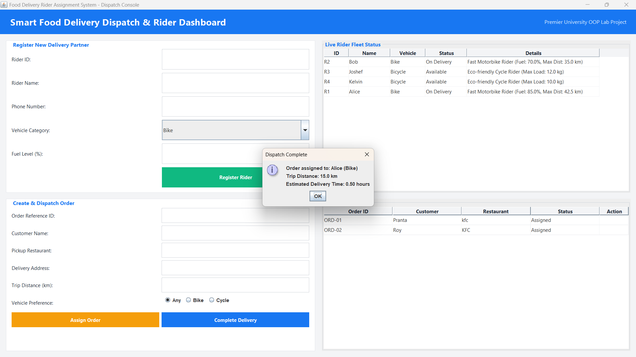
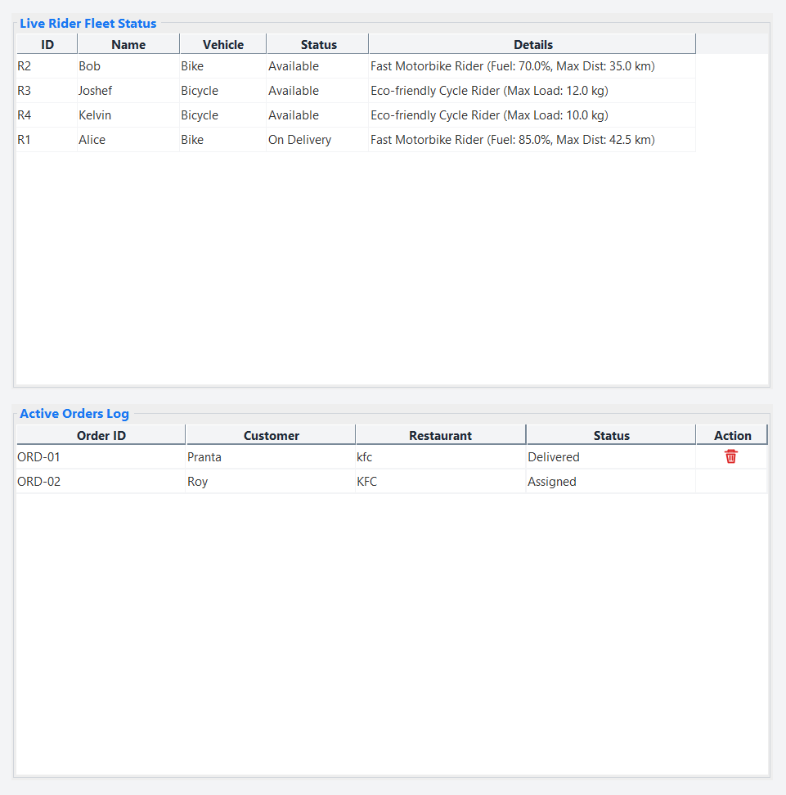
9
GUI & Dispatcher Dashboard
Java Swing console: register riders, dispatch orders, track live status
Visual Management
Live Status Board
One-Click Delivery
Add riders, place orders, track the fleet
Available vs On Delivery in real time
Complete Delivery frees the rider, order is Delivered

Slide 10
10
Conclusion & Future Scope
Academic Outcome
Future Enhancement
Inheritance: 3-level Person > Rider > Bike/Cycle
Polymorphism: overriding + overloading
Assignable interface + custom exception
HashMap / ArrayList collections
Swing GUI dispatcher dashboard
GPS-based live map tracking
Dynamic fuel calculation
Database integration
Rider rating and customer app
Thank You | Q/A Session
Pranta Mohajan (0222510005101025) Shreya Sen (0222510005101029) Arpita Paul (0222510005101033)

